Slide 1
Regularization and trade-off between bias and variance
Ali Madani
Farnoosh Khodakarami

Slide 2
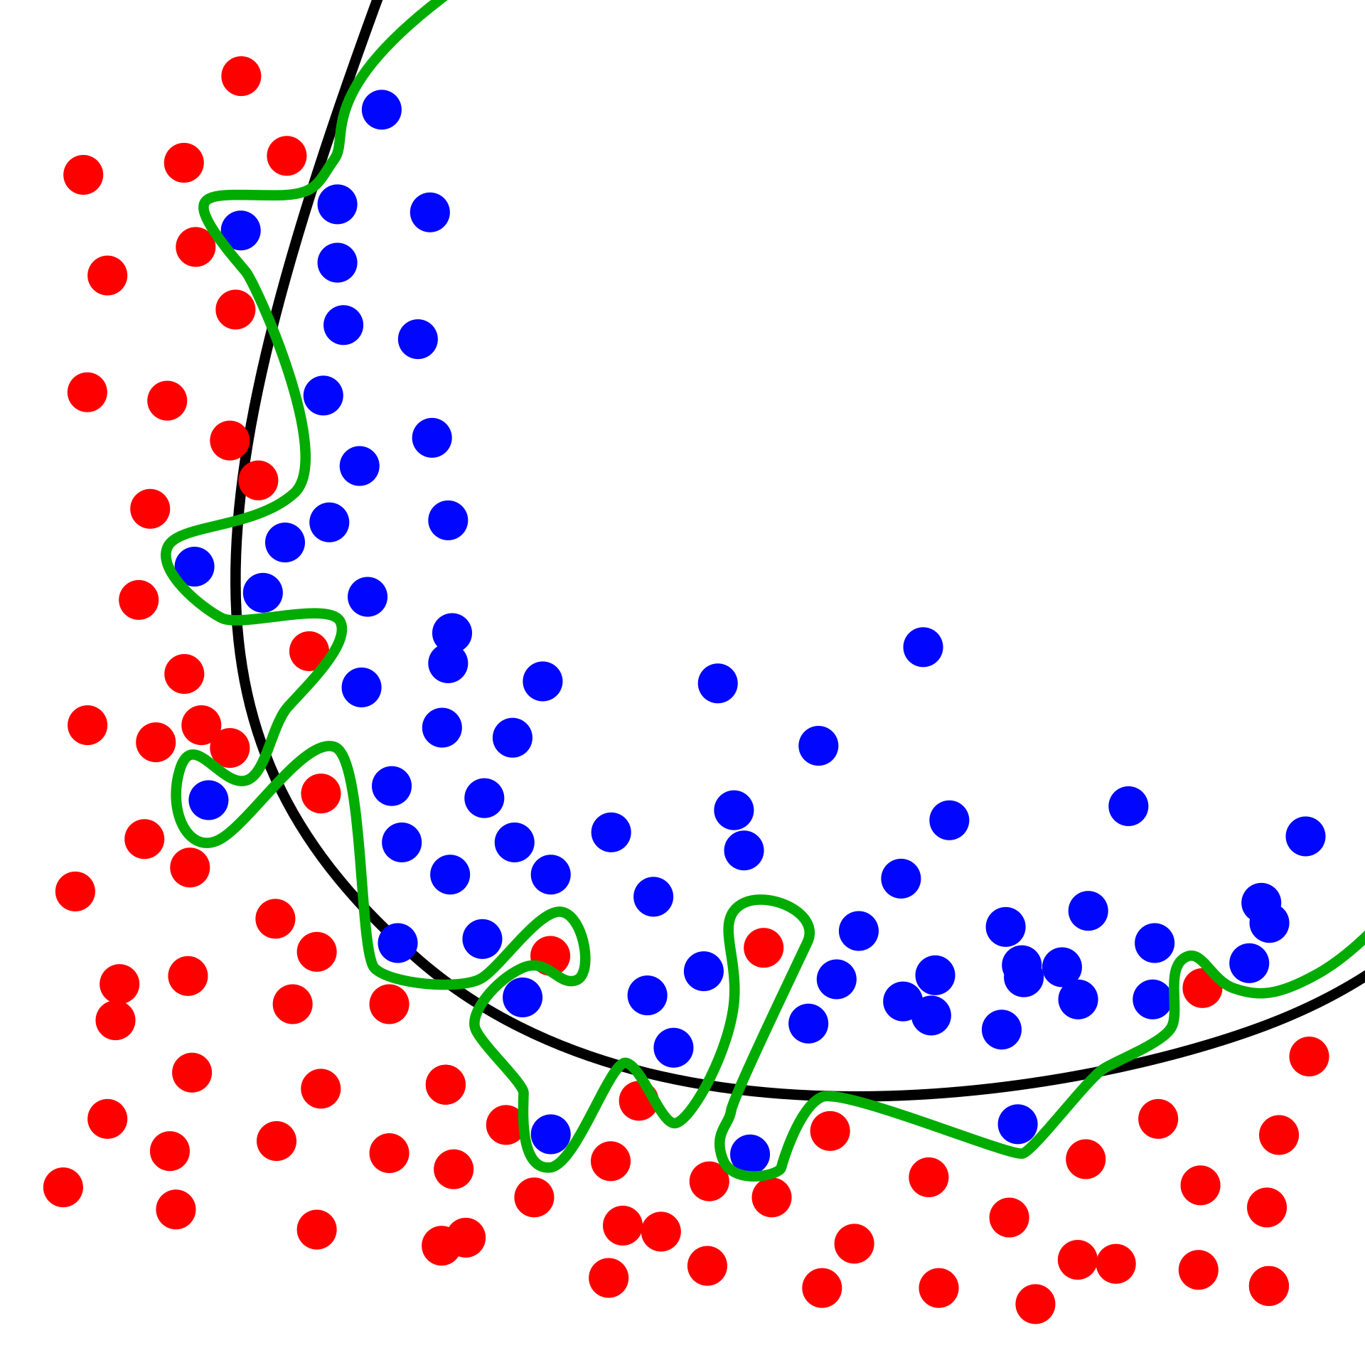
Overfitting
Overfitting: Good performance on the training data, poor generalization to other data.
Underfitting: Poor performance on the training data and poor generalization to other data
Image source wikipedia

Slide 3
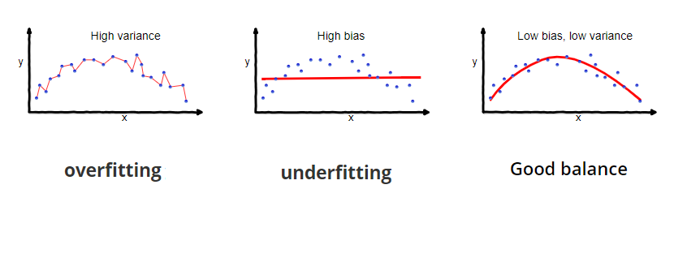
Bias–Variance Tradeoff
Notes:
What is bias?
Bias is the difference between the average prediction of our model and the correct value which we are trying to predict. Model with high bias pays very little attention to the training data and oversimplifies the model. It always leads to high error on training and test data.
Low Bias: Weak assumptions regarding the functional form of the mapping of inputs to outputs.
High Bias: Strong assumptions regarding the functional form of the mapping of inputs to outputs.
What is variance?
It captures the impact of the specifics the data has on the model.
Variance is the variability of model prediction for a given data point or a value which tells us spread of our data. Model with high variance pays a lot of attention to training data and does not generalize on the data which it hasn’t seen before. As a result, such models perform very well on training data but has high error rates on test data.
Low Variance: Small changes to the model with changes to the training dataset.
High Variance: Large changes to the model with changes to the training dataset.

Slide 4
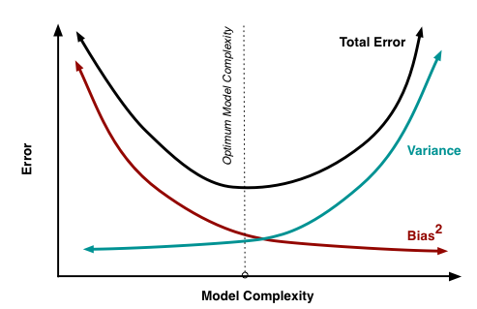
Bias–Variance Tradeoff

Slide 5
Training, validation and test set
Data | Use | Size
Training | Model training (parameter optimization) | Big
Validation | Assessing variance and hyperparameter optimization | Big or small Smaller than training
Test | Assessing variance | Smaller than validation

Slide 6

Training, validation and test set
Data | Use | Size
Training | Model training (parameter optimization) | Big
Validation | Assessing variance and hyperparameter optimization | Big or small Smaller than training
Test | Assessing variance | Smaller than validation
New data | I am the goal | Very small

Slide 7
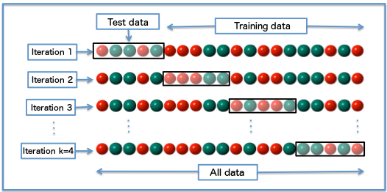
K-Folds Cross Validation to assess variance
Image source wikipedia

Slide 8
Training, validation and test splits (one dataset)
All data

Slide 9
Training, validation and test splits (one dataset)
All data
Holding out part of the data for assessing the model
Training
Test

Slide 10
Training, validation and test splits (one dataset)
All data
Holding out part of the data for assessing the model
Training
Test
Full:
Model training
Variance assessment and hyperparameter optimization
Testing the model
Cross-validation
Test

Slide 11
Accuracy in validation
Training
Validation
10-fold cross-validation
 |  |  |  |  |  |  |  |  | 1
 |  |  |  |  |  |  |  | 2
10

Slide 12
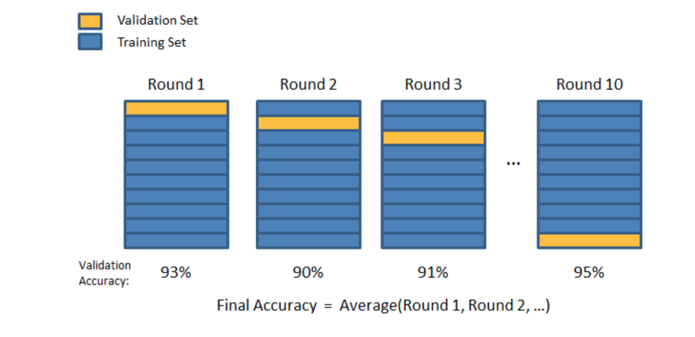
Accuracy in validation

Slide 13
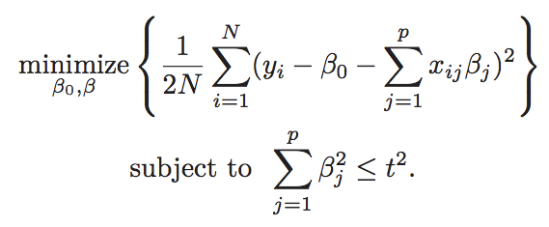
Regularization to overcome overfitting
Ridge regression
Objective function:
Constraint for regularization:
Hastie, T., Tibshirani, R., & Wainwright, M. (2015). Statistical learning with sparsity: the lasso and generalizations. Chapman and Hall/CRC

Slide 14
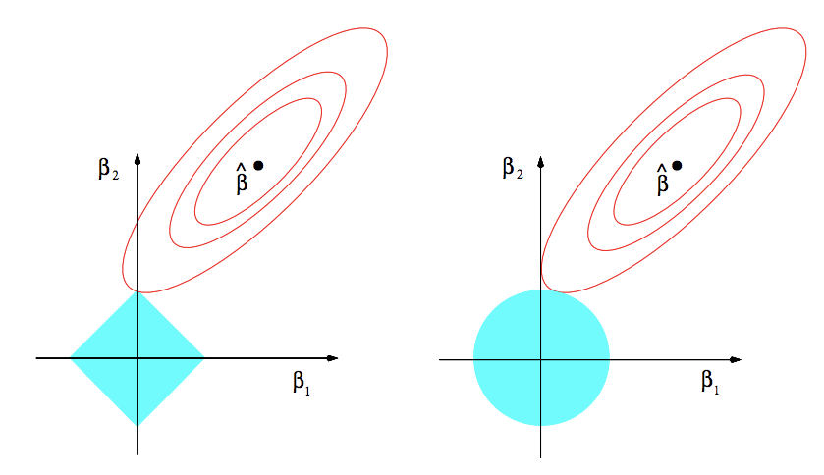
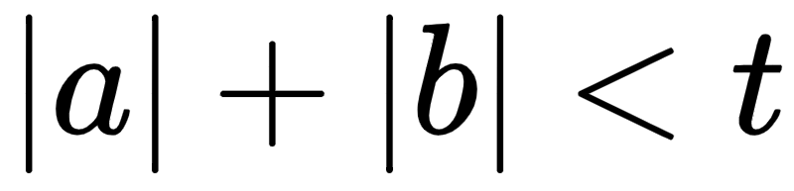
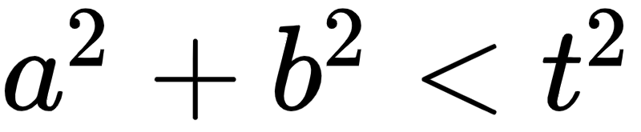
Optimization space in regularization
Lasso
Ridge
contours of the residual-sum-of-squares
b
b
a
a
Constraints
Hastie, T., Tibshirani, R., & Wainwright, M. (2015). Statistical learning with sparsity: the lasso and generalizations. Chapman and Hall/CRC

